Slide 1
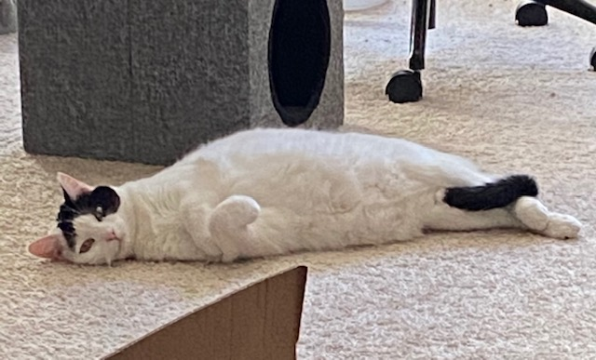
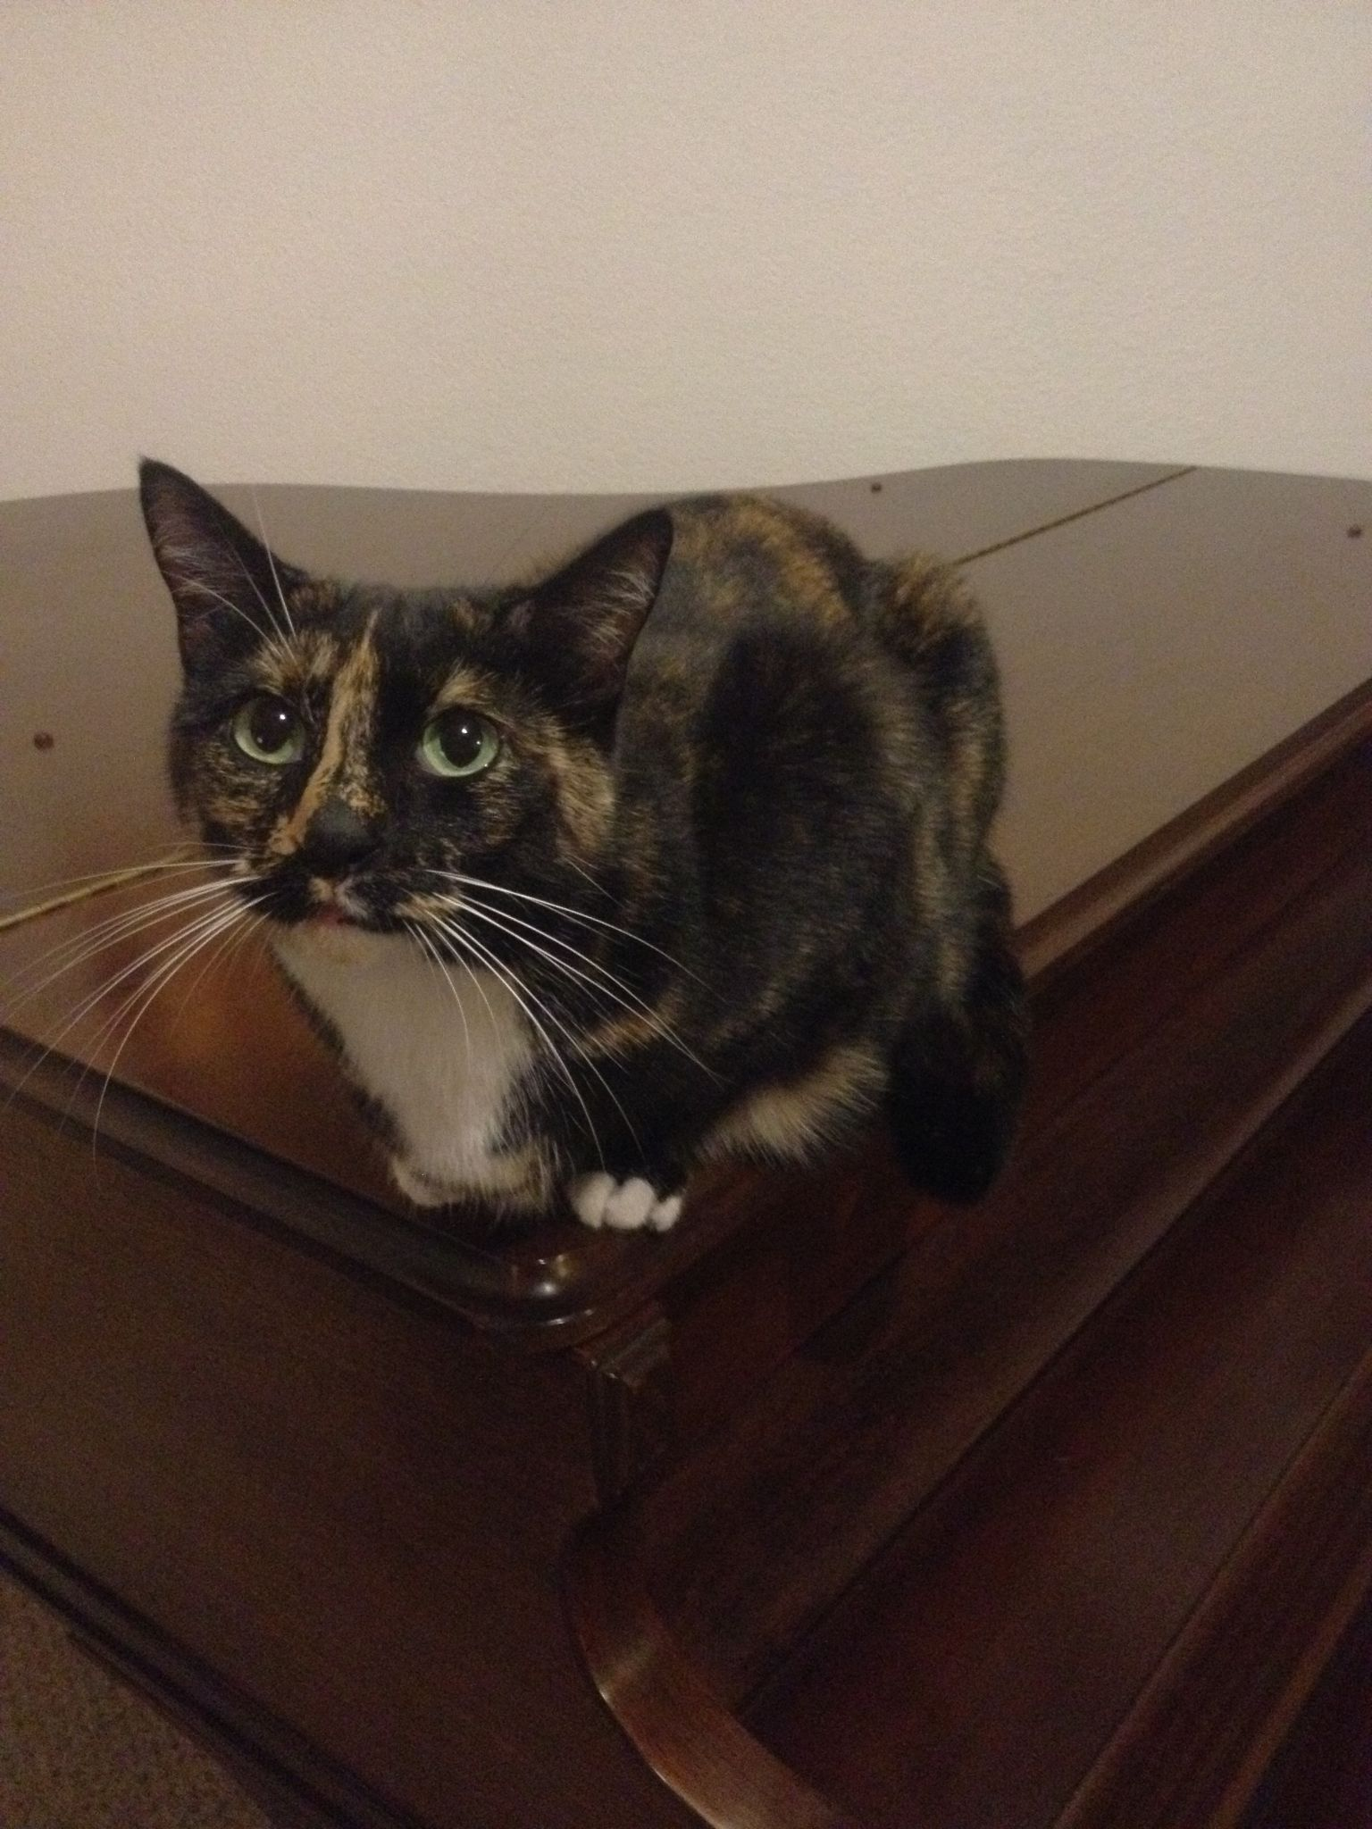
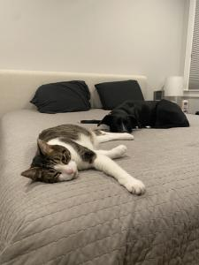
Pet Panel
Created by Adam, Kendra, and Kyle

Slide 2
“Pet Panel is an forum discussion webpage. Users are able to submit their own posts to categories, and comment on the posts of other users. In the future, users will be able to use the Pet Finder API to search for animal shelters in their area.”

Slide 3









Technologies Used
React
Material UI
Apollo
Mongoose
GraphQL
JSON Webtoken
Express.

Slide 4
Demo
https://github.com/asecord92/pet-panel

Slide 5
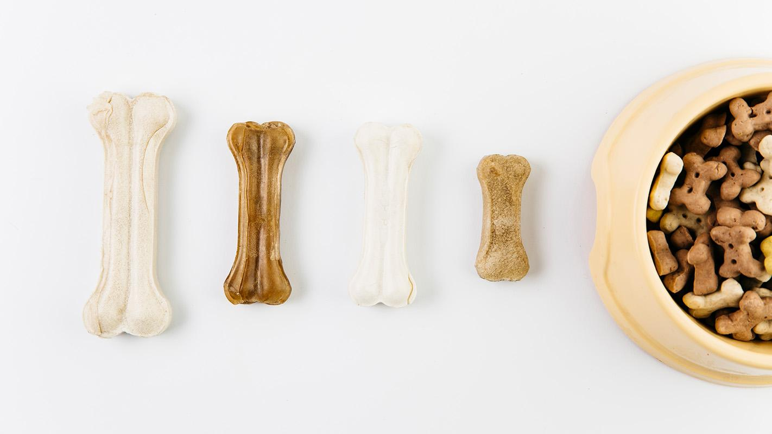
Future Developments

Slide 6
Future Development Goals
Better UI
Petfinder API: https://www.petfinder.com/developers/v2/docs/
Add and display pet profiles and user profiles
Photo storage and upload
Follow other pets and users

Slide 7
Contact
Kendra:
staverkendra@gmail.com
https://github.com/kstaver
Adam:
ats92@cox.net
https://github.com/asecord92
Kyle:
k.mcdowellr@gmail.com
https://github.com/K-Owell
Please keep this slide for attribution

